Slide 1
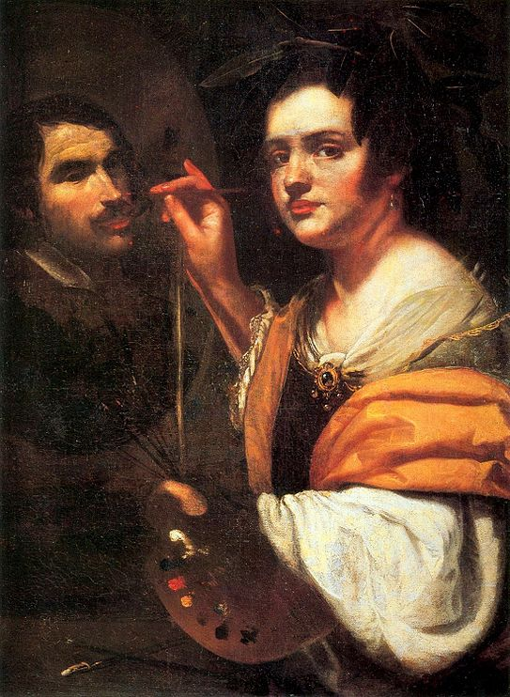
Artemisia Gentileschi
presentation by
Zubareva Natalia
BSE 195

Slide 2
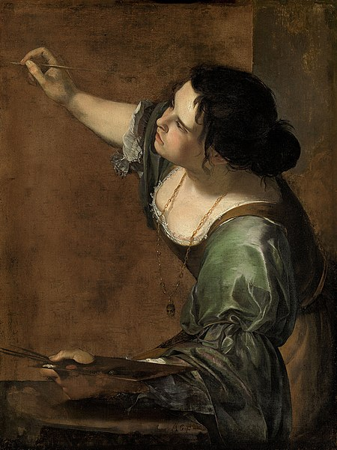
Briefly
an Italian Baroque painter
style of Caravaggio
was producing professional work
by the age of fifteen
the first female member of the
Accademia di Arte del Disegno
in Florence
worked for the Medici House,
Charles I of England, many more

Slide 3
Biography
was raped by her father’s coworker
July 8
born in Rome
moved to Florence
1593
1611
1611-1617
1605
1611
started painting in father's workshop
married Pierantonio Stiattesi
joined the Academy

Slide 4
Biography
moved to Rome
moved to Naples
moved back to Naples
1620
1630
by 1642
1626
1638
1656
moved to Venice
moved to London
died in the plague in Naples

Slide 5
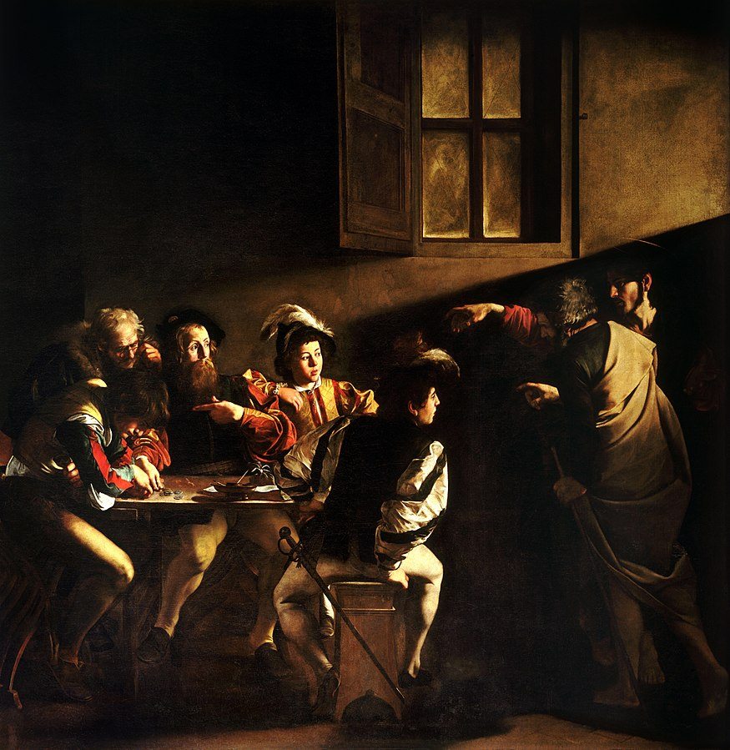
Caravaggism
dark colours
contrasting lighting:
blinding shaft of light and shadows
dramatism
realism
The Calling of Saint Matthew
Caravaggio (1599-1600)

Slide 6
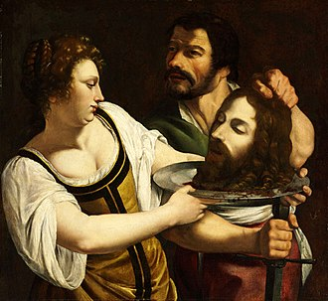
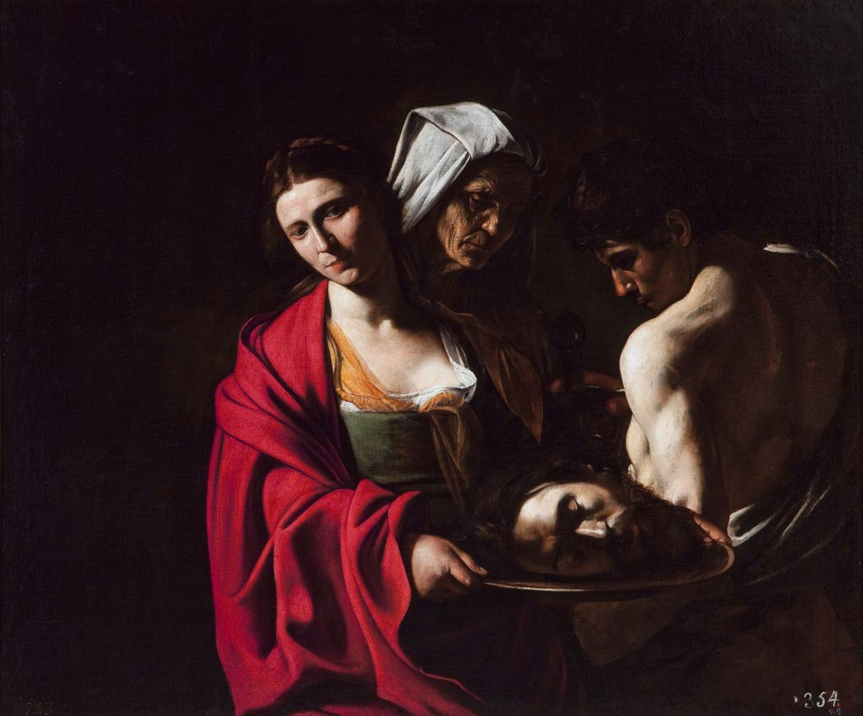
Salome with the head of St. John the Baptist
Gentileschi (1610-1615)
Salome with the head of St. John the Baptist
Caravaggio (1607)

Slide 7
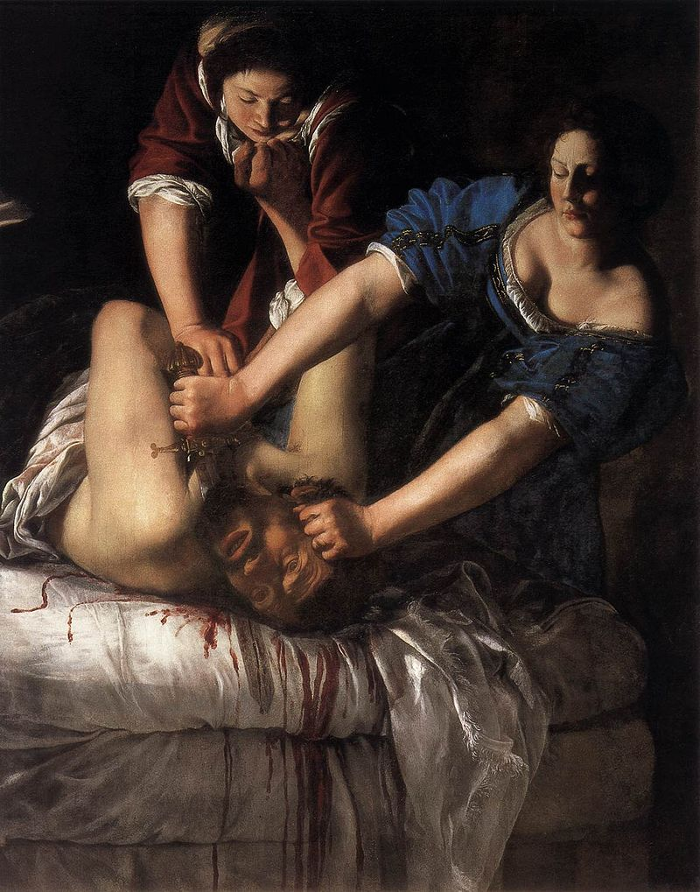
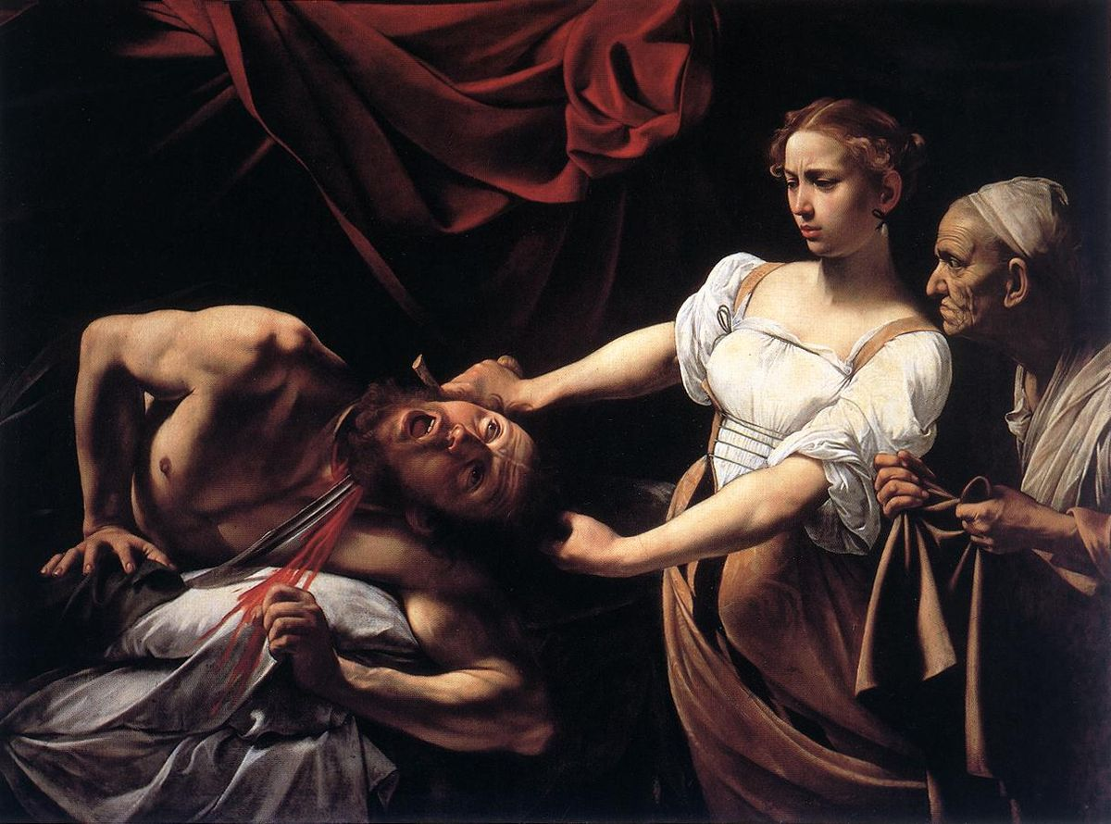
Judith Beheading Holofernes
Gentileschi (1611)
Judith Beheading Holofernes
Caravaggio (1598-1599)

Slide 8
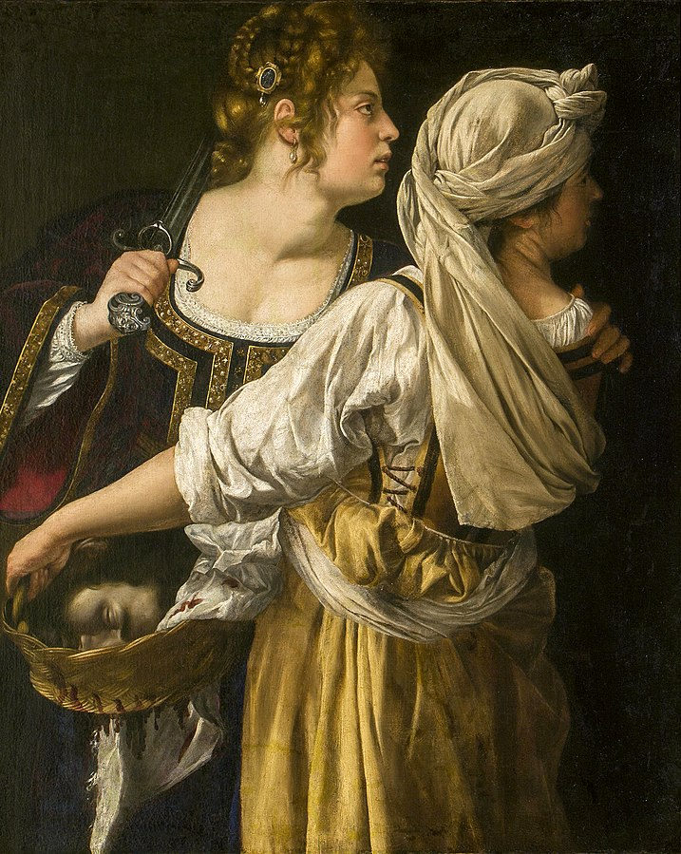
Art
influenced by Caravaggio
highly naturalistic
handling color to express
dimension and drama
female characters portrayed as
courageous, rebellious, and powerful
Judith and her Maidservant (1618-1619)

Slide 9
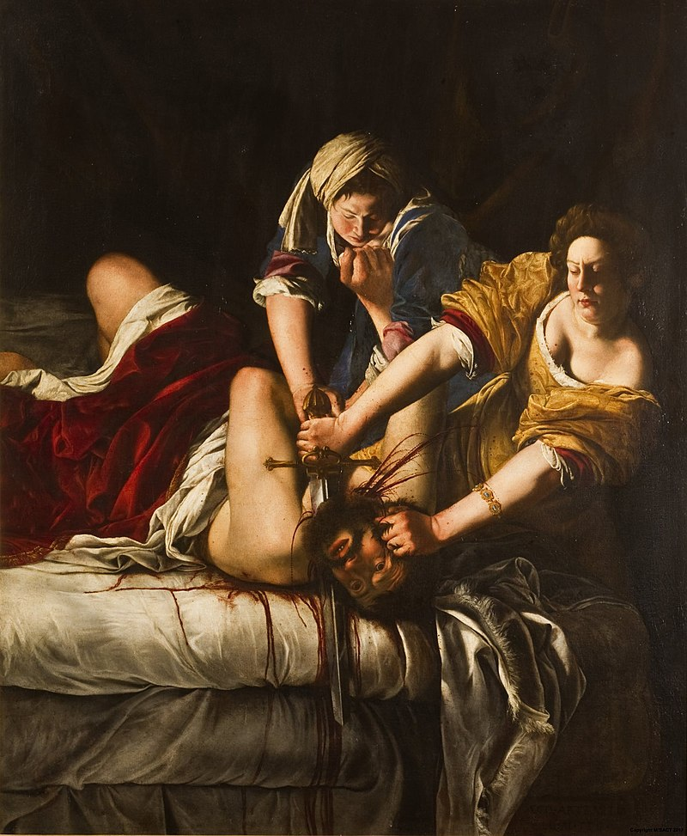
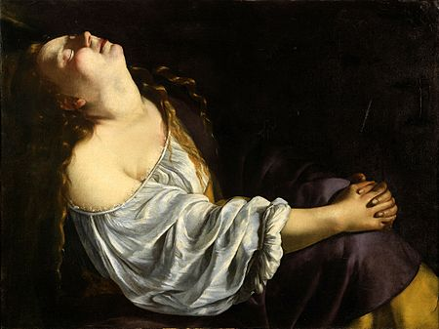
Judith Beheading Holofernes (1615)
Mary Magdalene in Ecstasy (1623)

Slide 10
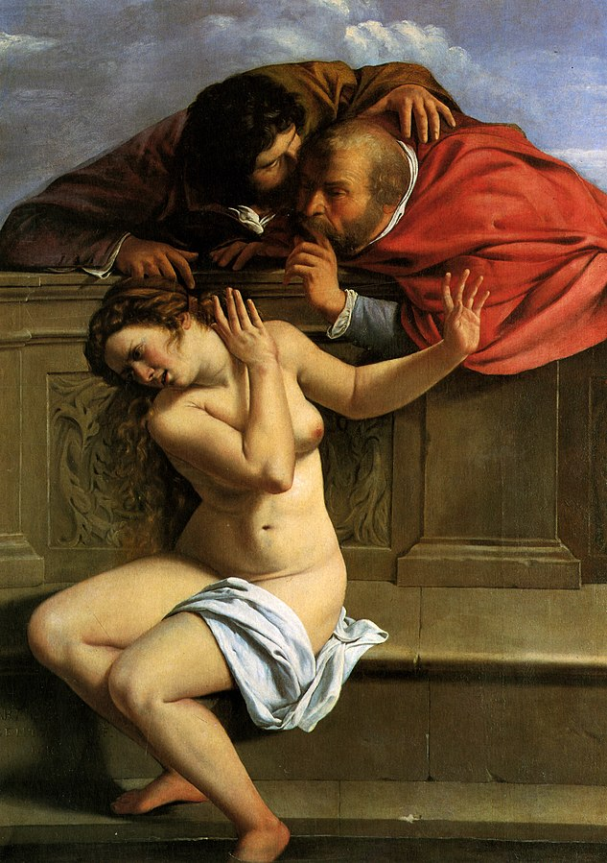
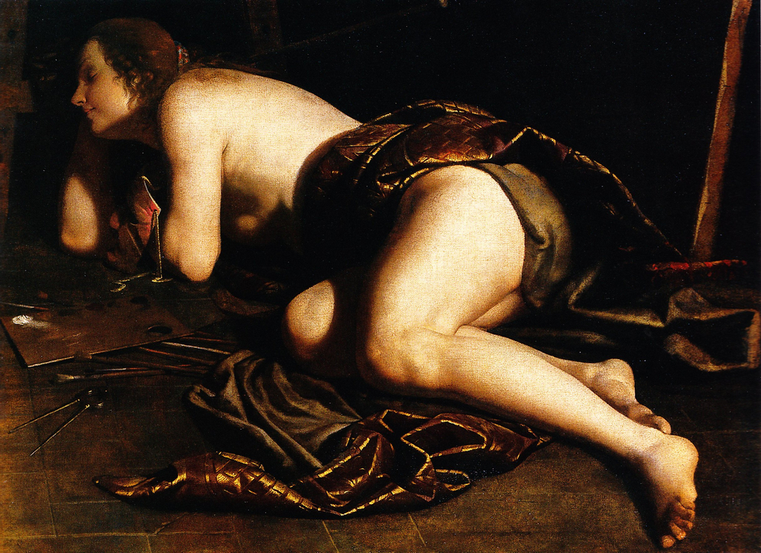
Susanna and the Elders (1610)
Allegory of Painting (1630-1640)

Slide 11
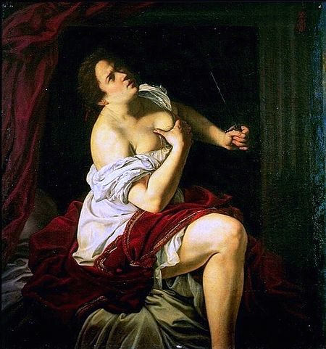
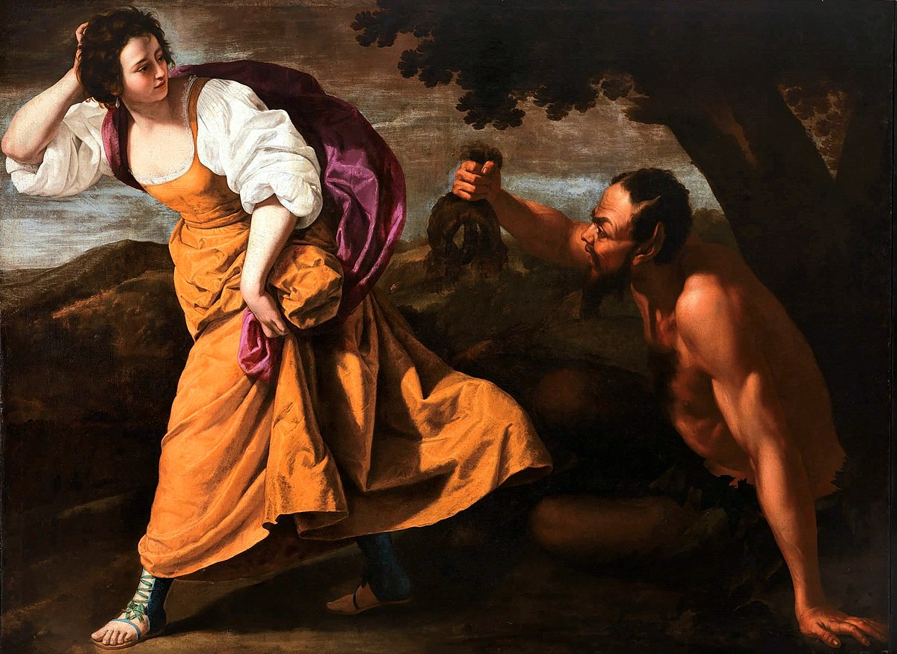
Lucretia (1623-1625)
Corisca and the Satyr (1630-1635)

